Slide 1
Business Process Engineering
Sobia Iftikhar

Slide 2
Content
Business Process Architecture

Slide 3
Business Process Architecture
A Business Process Architecture is the overview of a set of business processes that reveals their inter-relations
Every company has a different process architecture that keeps on changing with time.
Process architecture recognizes the important concepts involved in company’s processes

Slide 4
A Business Process Architecture (BPA) is the primary artifact of process management and improvement. If you don't have a BPA.
Creating a BPA is not a trivial exercise, and since it will always be subject to change and the exploration of greater detail, it is a never-ending job
For me, a BPA is something quite specific. It is a hierarchical model of the business processes of an organization. Usually created, initially at least, to include the three highest levels, the process architecture provides a powerful visualization and management tool
Organizational management is difficult enough without creating more complexity.

Slide 5
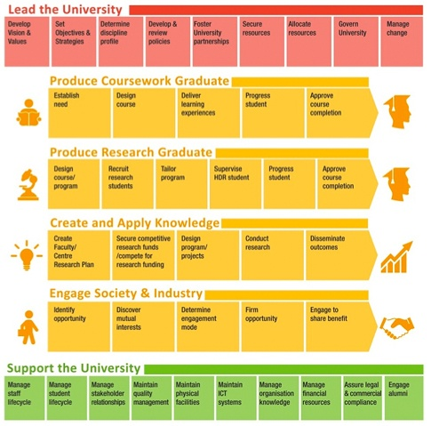
Example
BPA is a simple, but not simplistic, view of how the organization creates, accumulates, and delivers value
The format of the BPA picture used here is common enough showing management, core, and supporting processes.

Slide 6
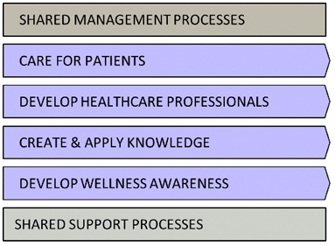
Example
The hospital cares for patients, develops healthcare professionals
The value propositions of, for example, create graduates and care for patients are embedded in the BPA because the highest level processes were derived from the organization's strategy. An organization's strategic intent is executed via its business processes so the BPA shows how strategy is operationalized.

Slide 7
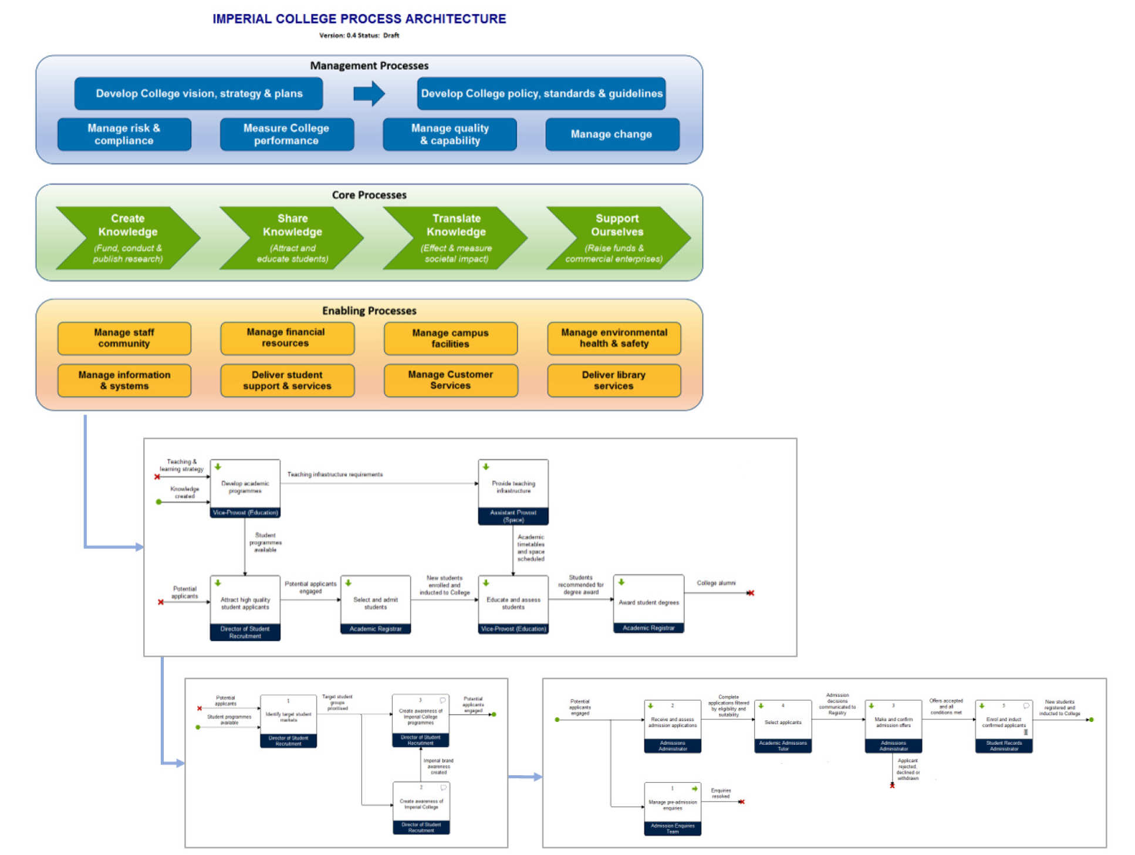
BPA TO BPM

Slide 8
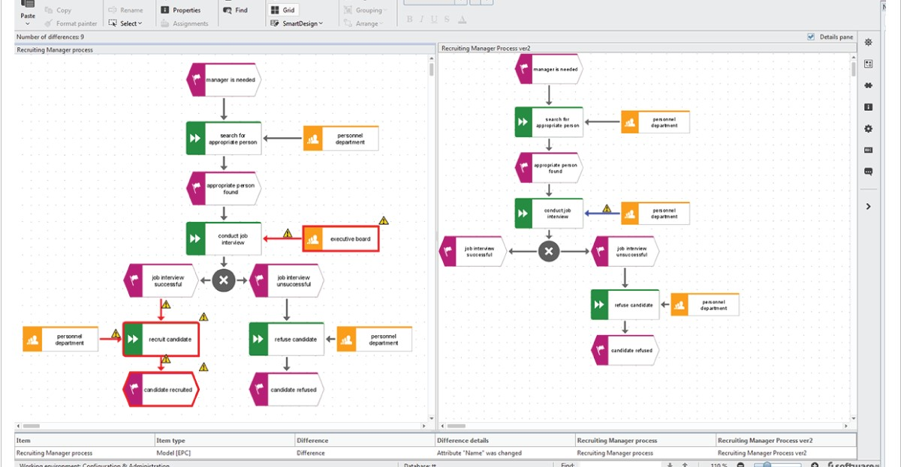

Slide 9
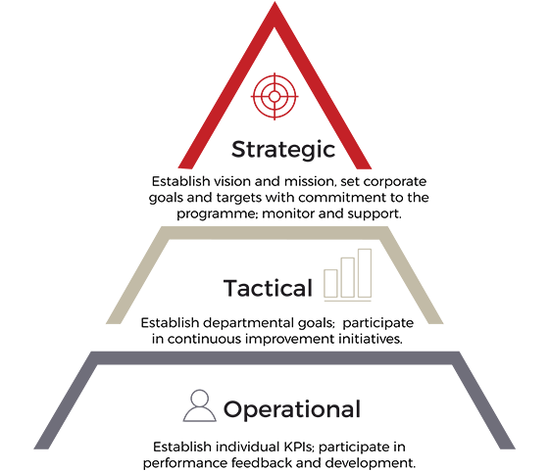
Business Process Architecture
It is a critical business blueprint that guides decision makers in executing strategy. Usually created to include, initially, the two or three highest levels,
Cross-functional business processes are the only way any organization can deliver value to customers and external stakeholders

Slide 10
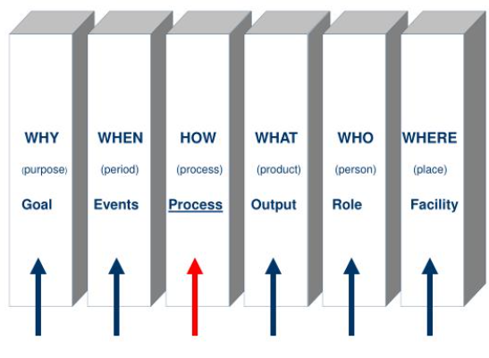
Focus for process

Slide 11
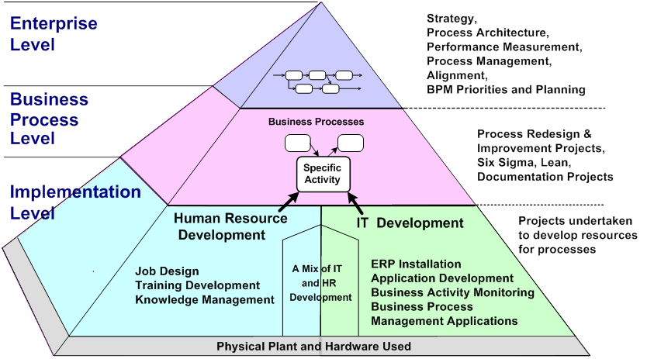
A Business Process Architecture
Connecting Business Strategy to Business Requirement

Slide 12
Using a Process Architecture
Focus on value
Enhance communication
Facilitate process performance management

Slide 13
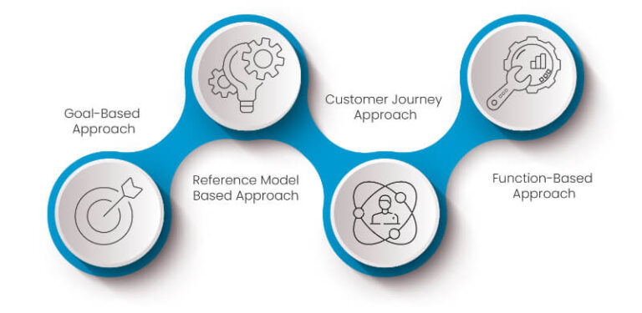
Business Process Architecture Design Models.
Ultimate goal is to make your process, ‘Better’, ‘Faster’ & ‘Cheaper’.
We apply the most efficient strategies and techniques tailor-made just to suit your needs. There are various approaches available to design business process architecture.
This led to five classes of approaches:
goal-based
action-based
object-based
reference model based,
function-based.

Slide 14
Goal Based
The goal-based approach establishes the relationship between a company's business goals.
This approach identifies the processes a company requires to achieve these goals.
By associating goals with processes, organizations can determine why certain activities are essential.
Companies assign key performance indicators (KPIs) to their business goals in this approach.
As companies have different goals, they also have diverse goal structures.

Slide 15
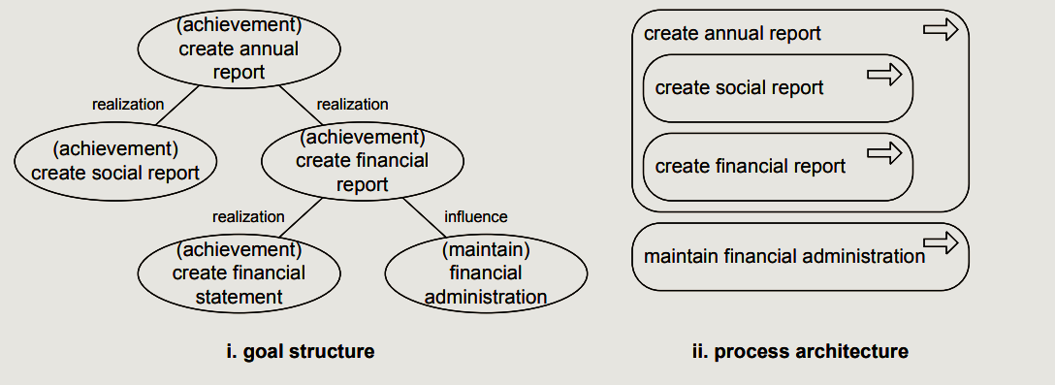
Goal Based
In the Goal-Based Approach, the business architecture is designed to establish essentials of business goals and relationships between business goals.
This approach identifies all critical business processes which are essential to achieve business goals.

Slide 16
Function Based
In a function-based approach, companies design the BPA hierarchy to represent the decomposition of business functions into details.
Decomposition is the practice of documenting all the sub-processes and tasks within a business.
For example, procurement and production are business functions. Using this approach can make it simpler to identify processes, allowing businesses to focus on their capabilities rather than on how they accomplish tasks.

Slide 17
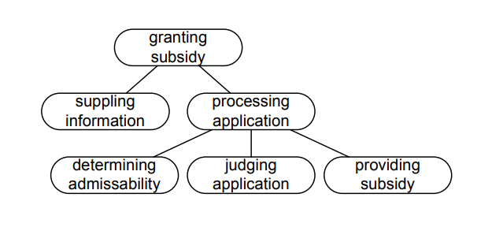
Function Based
For example, companies can decompose a production function into material planning, production planning, finished goods delivery, and receipt of goods. With this approach, companies can organize their business processes according to their functions and define them in more detail. Through this, they can gain the insight necessary to make informed decisions when considering the right process improvement strategies. The function-based approach is also helpful in finding the end-to-end value chain associated with a function, which comprises the process from purchasing raw materials to the product reaching the consumer.
The advantage of this approach is to find the End-to-End value chain associated with a function and assign a process owner along with the process measurement system.

Slide 18
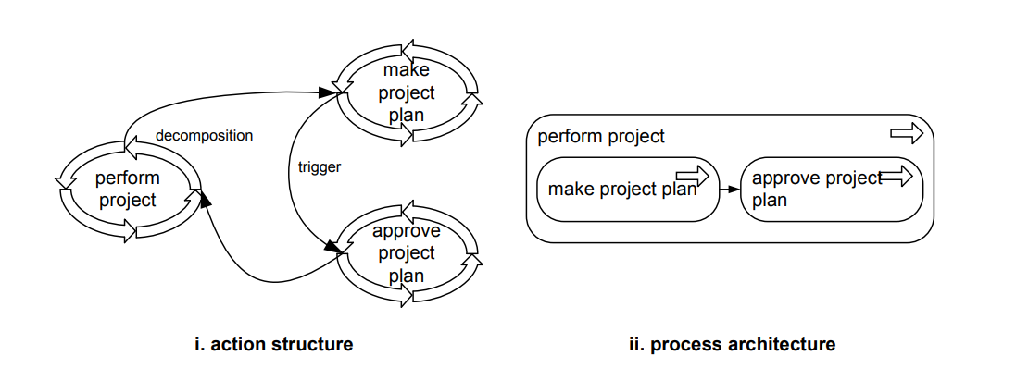
Action Based
When building this approach, organizations usually design a structure that includes business actions and their relationship.
A business action lists the activities necessary for a company to complete for its customers.
In this approach, each action generally follows a certain phase or pattern.
This often makes it suitable for identifying, delimiting, and dividing a process into variants or sub processes.
It also ensures consistency in business operations, as every pattern follows the same basic guidelines.

Slide 19
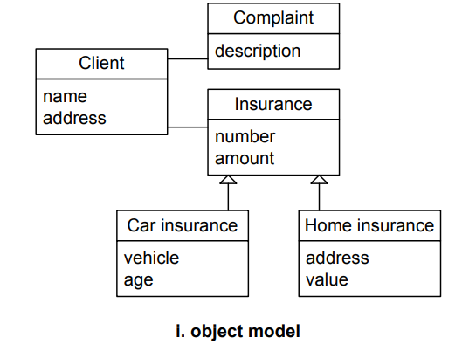
Object Based

Slide 20
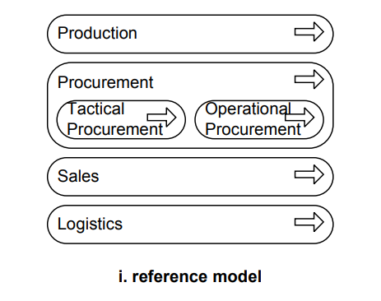
Reference Based
These reference models can be re-used and adapted by the organization, as per their requirement to design their business process architecture.
There are various industry-specific as well as management-related reference models are available. Some of these are APQC process frameworks for specific industries, Malcolm Baldridge Industry-specific Frameworks (like Healthcare, Education, etc), European Framework for Quality Management System (EFQM), or standards like ISO 27001 for Information Security, etc.

Slide 21
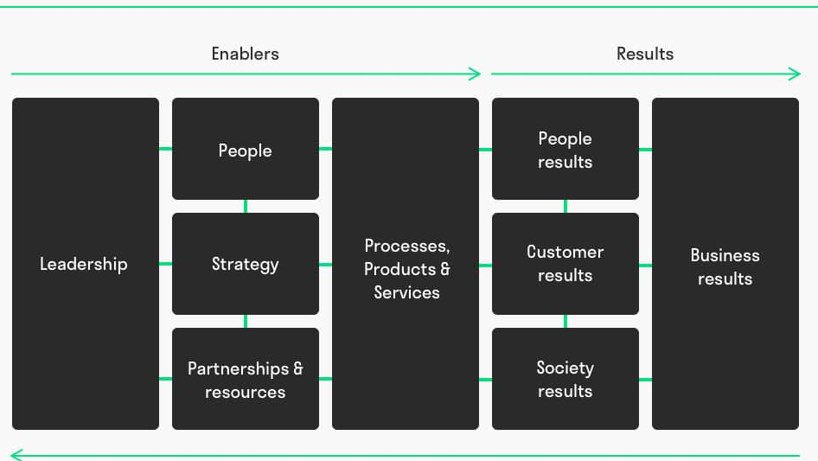
European Framework for Quality Management System (EFQM)
EFQM was founded in 1988 with the objective to create a platform where organizations can learn from each other to continuously improve their performance.
The EFQM Model or EFQM business excellence model is the most popular quality management tool in Europe, used by more than 30.000 organizations to improve performance. It supports you to self-assess and reflect. 84% of our members say that the EFQM model helps to improve their organization.

Slide 22
Business Process Management Architectures
business process management architectures and evaluates them with respect to their properties. It is organized as follows.
workflow management systems architectures
Service-oriented architectures
Data-driven approaches

Slide 23
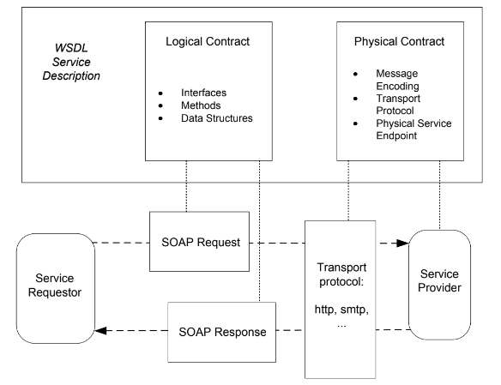
Web Services and their Composition

Slide 24
Can we align Business Process Management (BPM) and Business Process Architecture (BPA) together?
Incorporating business process management (BPM) and business process architecture (BPA) together is definitely the way forward.
It can be rightly said that BPA is the one of the cores of BPM.
BPA allows you to manage your processes much more efficiently.
For BPM to work effectively, it needs appropriate and structured methodologies. Business process architecture model provides that structure.

Slide 25
Business Process Management Architecture
Purpose:
To discuss the evolution of enterprise systems architecture
Investigate business process management architectures and evaluates them with respect to their properties.
We will look in following manner:
workflow management systems architectures
Web Service Technology (Service Oriented Architecture)
Web Service Composition
Data-driven approaches

Slide 26
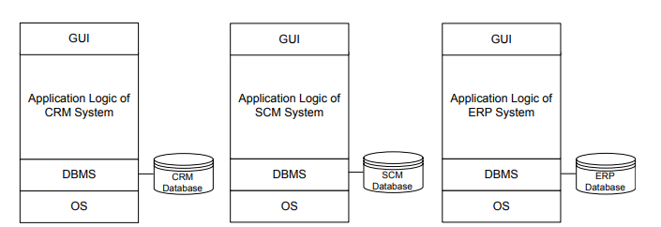
workflow management systems architectures
Workflow models are the blueprint for implemented business processes in workflow management systems.
Workflow models need to be in line with business process models that capture the operational business processes
workflow management systems have been identified as an important step in the evolution of business process management systems

Slide 27
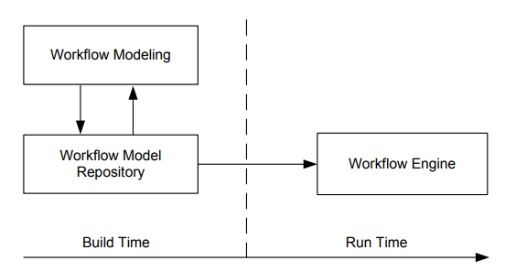
workflow management systems architectures
When a workflow model has been created that satisfies the requirements imposed by the business process, workflow modelling has completed.
workflow model is represented by a script, written in the workflow language of that system.
Workflow models can also be stored in a database or workflow model repository.
In any case, the workflow modelling tool is terminated after workflow modelling has completed, i.e., after the build time of the workflow.

Slide 28
workflow management systems architectures
Workflow instances typically live in the main memory of the process engine,
which controls the execution of workflow instances.
The process engine decides for a given workflow instance which activities can be started, and it communicates with workflow client applications, which are accessed by process participants.

Slide 29
workflow management systems architectures
Workflow management systems architectures organize the subsystems that are involved in the design and enactment of both system workflows and human interaction workflows
The architecture contains the following subsystems and roles, whose responsibilities are described as follows:
Workflow Modelling: subsystem provides means to model the technical aspects of implemented business processes The workflow models are stored in a Workflow Model Repository.
Workflow Engine: is responsible for enacting workflow processes

Slide 30
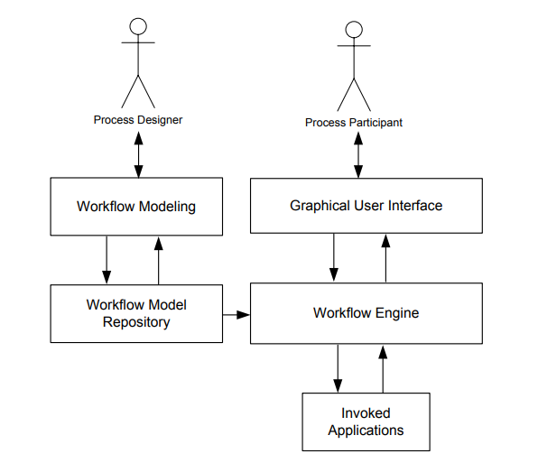
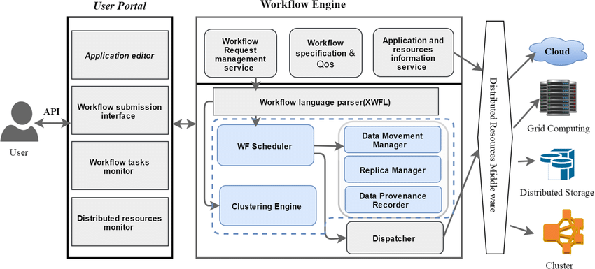
workflow management systems architectures

Slide 31
flexible workflow management
https://fioriappslibrary.hana.ondemand.com/sap/fix/externalViewer/#/detail/Apps('F5343')/S21OP

Slide 32
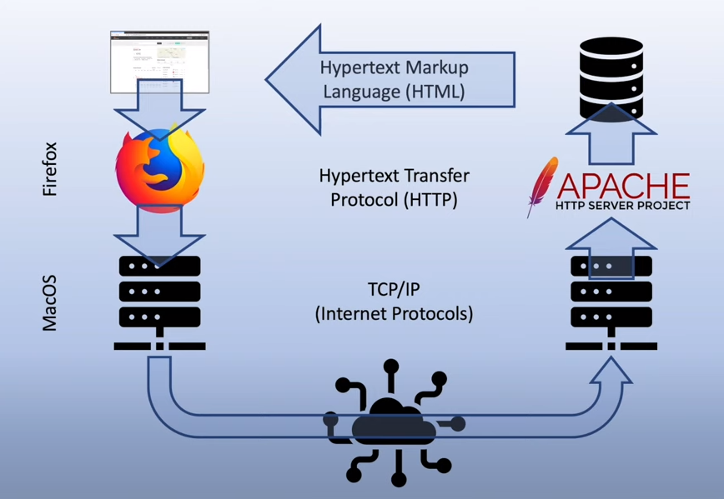
Web Services and their Composition Web service Technology
WEB PAGE
Enter address
Browser Send request to web application Protocol (http)
Mac OS
Tc/IP
Receiving OS
Web server to application retrieve the page from data base
HTML Send back to my computer

Slide 33
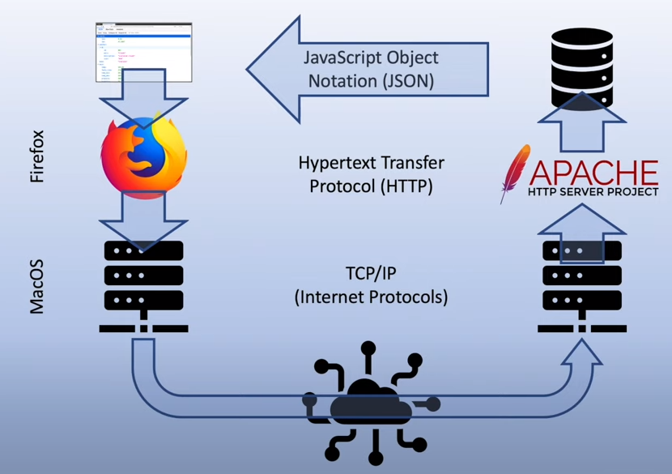
Web Services and their Composition Web service Technology
WEB Service
Enter address
Browser Send request to web application Protocol (http)
Mac OS
Tc/IP
Receiving OS
Web server to application retrieve the page from data base
HTML Send back to my computer

Slide 34
Web service
Mobile Phone
AI devices
Web pages
All can use same web service bus in a different way.
Web services provide the raw data

Slide 35
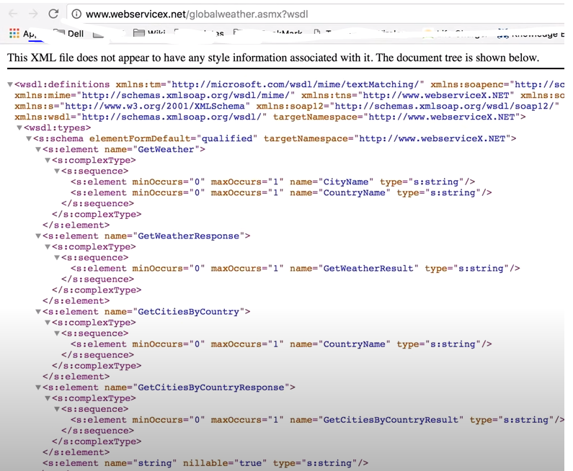
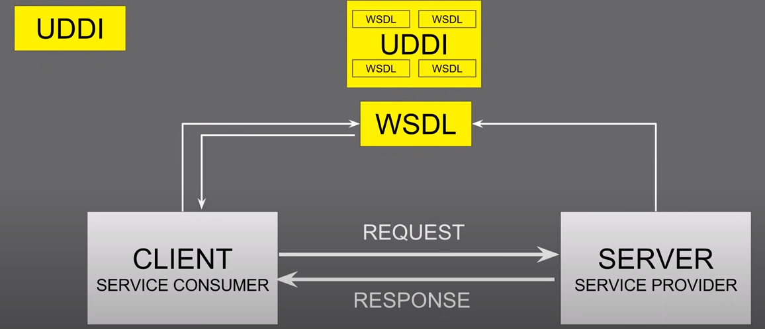
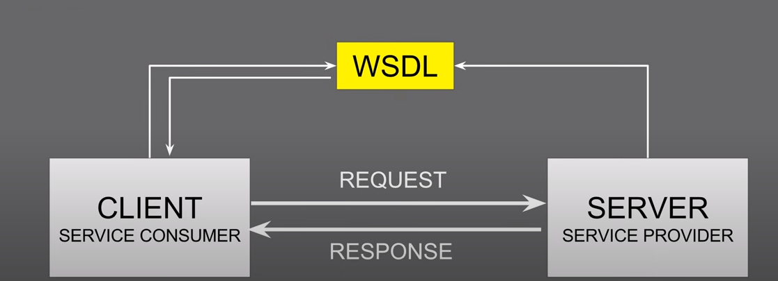
Web Services and their Composition Web service Technology
Soap: Simple Object Access Protocol
Its is a COMMUNICATION protocol . How two Application will take to each other
WSDL
UDDI

Slide 36

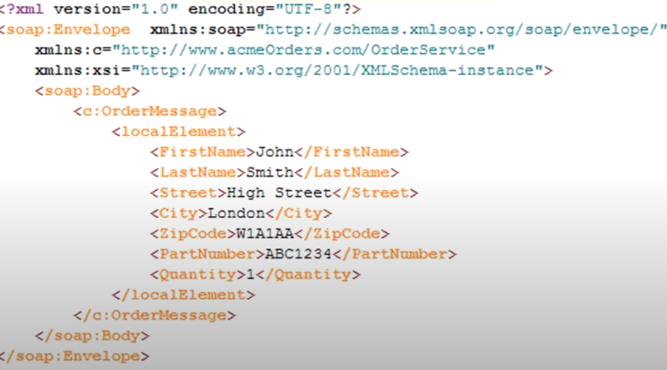
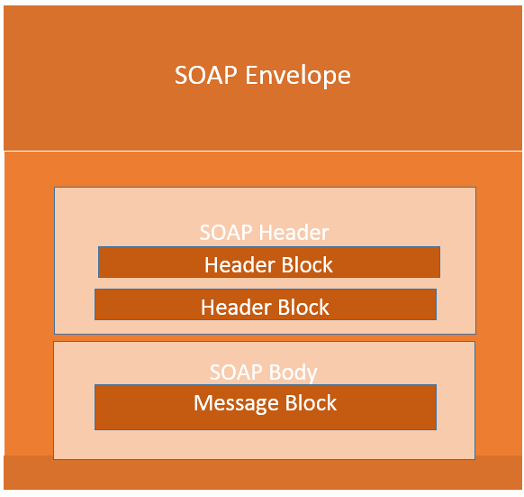
Web Services and their Composition Web service Technology
Soap: Simple Object Access Protocol
Its is a COMMUNICATION protocol . How two Application will take to each other
WSDL
UDDI

Slide 37
Web Service Composition (BPEL)
https://langrid.org/services/en/exercise3.html
Web service composition involves integration of two or more web service to achieve more added value of business functionality. A work flow composer is responsible of aggregating different web services to act as a single service according to functional requirements as well as QoS constrains. BPEL is one of the popular composers uses XML language to perform service composition. Fine-grained services perform single business task and provides higher flexibility and reusability. However, coarse-grained service involves performing complex business functionality leading to lower flexibility

Slide 38
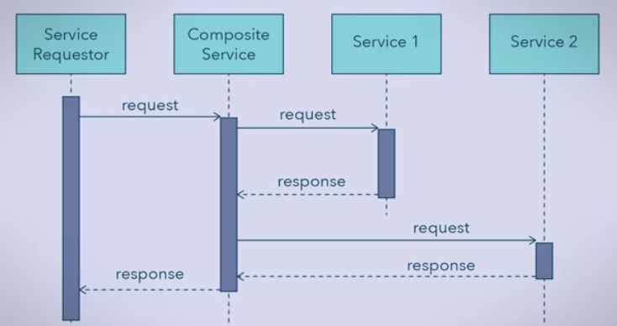
Service Composition

Slide 39
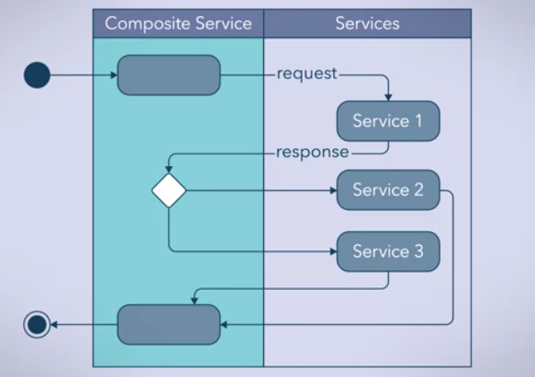
Service Composition
Invoke by Soap
Describe by WSDL
Catalogued by UDDI

Slide 40
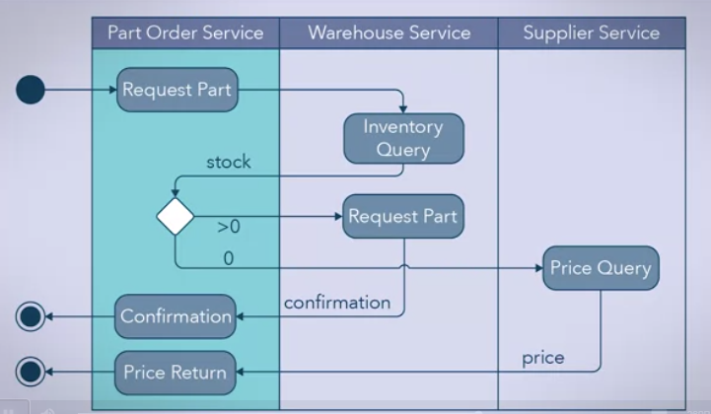
BPEL
It’s a high level composition language.
Its also called WS-BPEL
Developer can compose multiple services into one services.

Slide 41
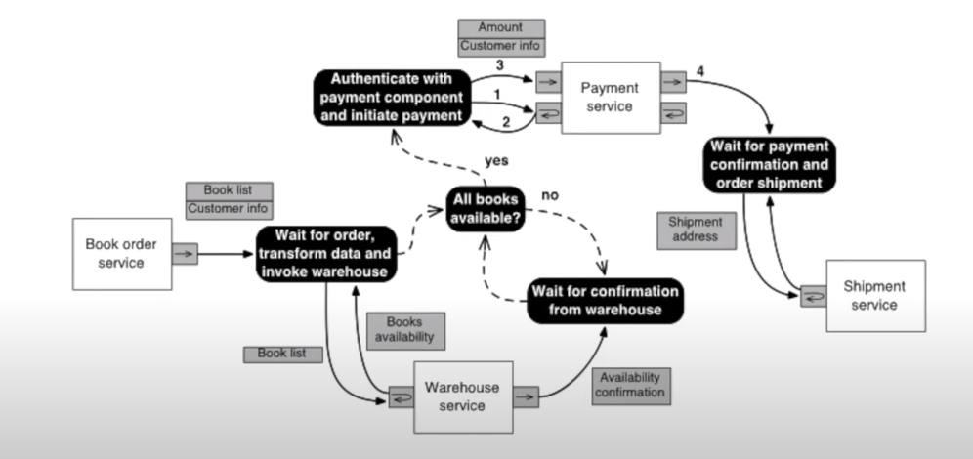
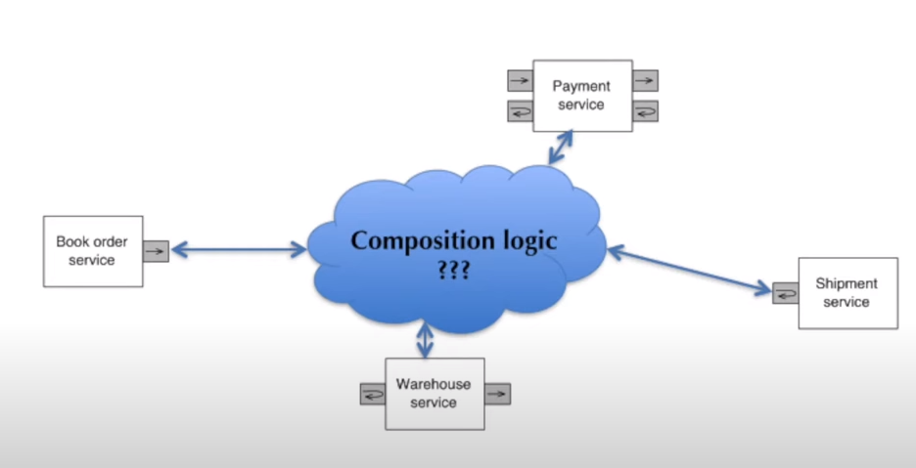

Slide 42
The following types of activities are available in BPEL.
• Invoke: Invoke an operation offered by a Web service; this invocation may
or may not have a response
• Receive: Wait for a message to arrive
• Reply: Send a reply in response to a receive message
• Wait: Wait for a specified time period
• Assign: Assign data values, for instance, from received messages to process
variables
• Throw: Indicate that an error has occurred; used for exception handling
• Terminate: Complete the process

Slide 43
Activities in BPEL can be related to each other using the following control flow structures.
Sequence: Define a block consisting of an ordered sequence of activities
• Switch: Based on an expression, select a particular activity from a set of
possible alternatives
• Pick: Wait for a suitable message to arrive or for a time-out event. On
receipt of the message (or the time-out event), start a defined activity
• While: Execute a set of activities as long as a condition is evaluated to
true
• Flow: Concurrently execute a set of activities
• Link: Execution constraint between activities

Slide 44
